Slide 1
Stock Market Prediction Based on Markov Model
Presented by:
Akshat Kumar(10900210041)
Rima Roy(10900210017)
Rohit Kumar Rai(10900210020)
Satrajit Das(10900210068)
Under the guidance of:
Prof. Chandan Banerjee

Slide 2
ABSTRACT
Stock market analysis and prediction is one of the interesting areas in which past data could be used to anticipate and predict data and information about future.
Using the stochastic process called Markov Chains, we sought out to predict the immediate future stock prices for a few given companies.
This application is based on PHP and MySql.

Slide 3
INTRODUCTION
In our project, we analyzed a year’s worth of stock portfolio for a selected group of companies and apply moving averages and Markov Chains to the data in hopes to predict the stock prices for the near future.
The first thing we did was to apply moving averages to create an approximate evaluation of the data. We then found a difference data set to apply Markov Chains to. We took the difference of the closing price and the moving average price. These differences were going to be what we applied Markov Chains to.
By applying Markov Chain properties to the data set, we then formed the transition matrix and calculated the steady state probabilities to make the predictions.

Slide 4
Related Work
There has been much work done in the field of stock market prediction which has been based on neural network, hidden Markov model etc.
To keep our project simple with a decent level of accuracy, and also owing to the time constraint we opted for Markov chain process to make the predictions.
The field of prediction is progressing each day, with constant attempts to increase the accuracy of the predictions and hence this project also leaves a lot of chance for future works and enhancements.

Slide 5
ALGORITHM WE HAVE USED TO BUILD THE APP
MARKOV MODEL
The Markov process is a random process characterized as memory less: the next state depends only on the current state and not on the sequence of events that preceded it.
A sequence of states: X₁, X₂, X₃, … such that
P(Xk+1 = y|X1 = x1…..,Xk = xk ) = P(Xk+1 = y|Xk = xk)
P(Xk+1 = y | Xk = x) = P(X2 = y |X1 = x)
The transition from X_{t-1} to X_{t} depends only on X_{t-1} (Markov Property).
Markov chains are often described by a directed graph, where the edges are labelled by the probabilities of going from one state to the other states.

Slide 6
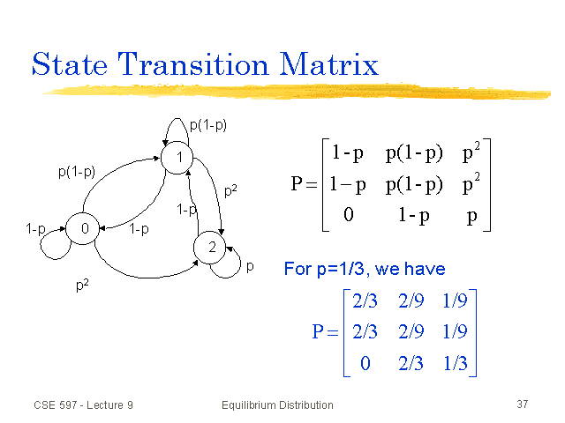
Markov Chain Process and Subsequent Transition Matrix

Slide 7
PROCESS OVERVIEW
Data Collection & Analysis
Moving average calculation
Determination of the transition matrix
Probability determination of each transition
Determination of the steady state probabilities
Calculation of the steady state probabilities to aid in prediction.
Prediction
Predict the most probable opening and closing values for the selected stock on the next day.
Bin calculation
Determination of the intervals(quartiles)
Depiction in the transition matrix

Slide 8
STEPS INVOLVED
We have selected one year’s worth data for five different stocks and have applied Markov chain calculations on this data in order to make the predictions.
The first step towards applying Markov chains to the data set began with the calculation of moving averages.
Moving averages provide a forecast for future prices and therefore are crucial to our work here.
Using the difference between the forecasted and actual prices enabled us to make our predictions for the possibility of where future prices may lie. These moving averages were calculated for both opening and closing prices for an interval (called i) of 3 days.
After the moving averages were calculated for the set of stock prices, the difference between each actual price and the moving average of each individual day was calculated. This information is what we would use to predict future stock prices.

Slide 9
We then focused on binning each of the difference prices into four intervals set within the larger interval from the lowest difference price to the highest difference price.
The bins were calculated using the following formula:
K = sqrt(N), where K is the total number of bins and N stands for the total number of readings taken into consideration.
The width of each bin is calculated using the following formula,
w = (max value – min value) / K, where ‘max value’ and ‘min value’ refers to the max and min of the difference (between the actual value and the moving average).
The intervals were then calculated based on quartile calculations (i.e at intervals of N/4, 2N/4 and 3N/4).
Each of the intervals was labelled P1, P2, P3, P4 respectively.
After the intervals were established for each data set of difference prices, each individual difference price was labelled as to which interval it fell in.
Once each difference price was labelled with its corresponding interval, the number of transitions for each individual difference price interval to the next difference price interval was counted. The number of points belonging to each interval was also recorded.

Slide 10
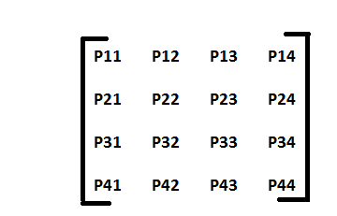
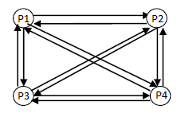
After this, the transition matrix was developed where each entry of the matrix is supposed to be the probability of the data points moving from, or transitioning from, one state to another, with the states corresponding to the appropriate rows and columns.
Our transition matrix is of the following form:
Let us say, that our transition matrix is represented by Q.
We iteratively compute Q², Q³, Q⁴, ……., Q⁸.

Slide 11
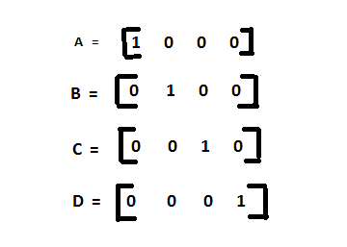
Then we have considered the steady state probability of being in a particular state as 1, that is, we form 4 steady state probability matrices to tell us the probability or possibility of the stock price lying in a particular range. The matrices are of the form:
Matrix A when multiplied with Q² , Q³ , ……, Q⁸ iteratively, finally give us the probability of the stock price lying in interval P1.
Similarly when matrix B is multiplied iteratively, it gives the probability of the stock price lying in interval P2, matrix C gives us the probability for interval P3 and D for interval P4 respectively

Slide 12
Workflow( Implementation) of our Web App

Slide 13
Firstly, we have taken the historical data from NASDAQ official website for five chosen stocks in the CSV format.
We have calculated the moving average and differences of the stocks in Excel 2013 and then it was imported into the MySql database.
All the backend collections like bin, quartiles, transition probabilities and transition matrix was calculated using PHP.
The whole website has been designed using HTML5, CSS3 and Javascript.
It is a responsive website so that it can adapt to different screen sizes.
We have also added the facility to follow the current stock prices which are fetched using Yahoo Finance at runtime.
We have also added a yahoo finance badge in our website which keeps the user updated about current stock market trends.

Slide 14


Slide 15
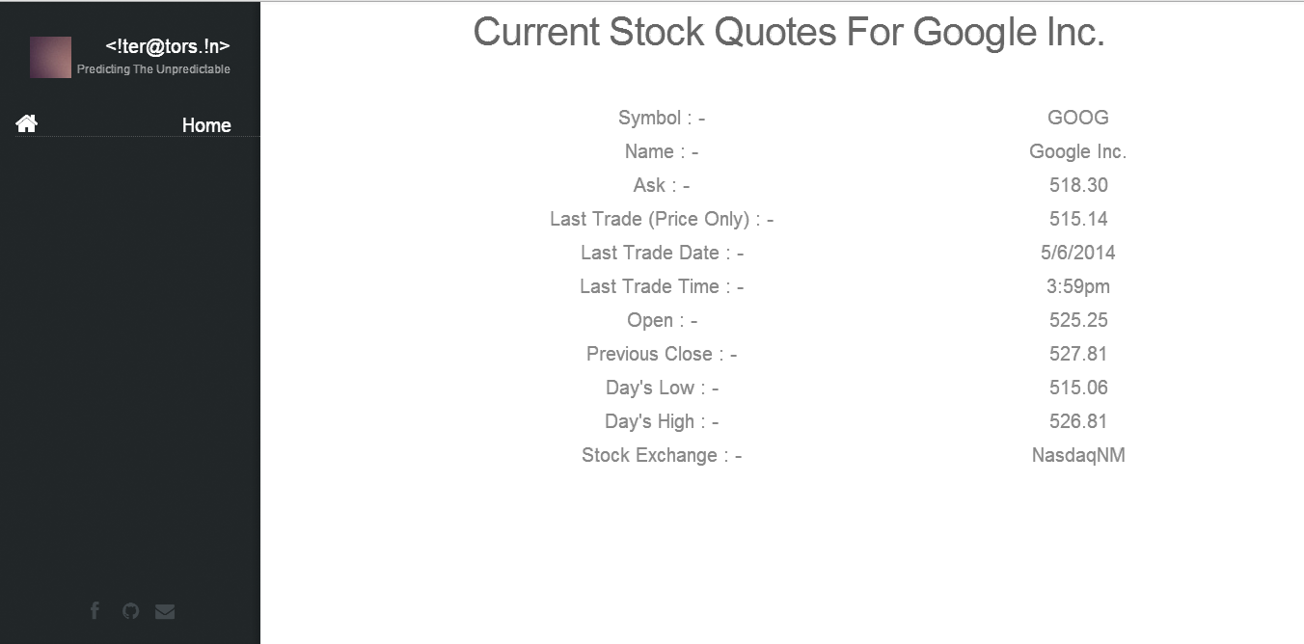

Slide 16


Slide 17
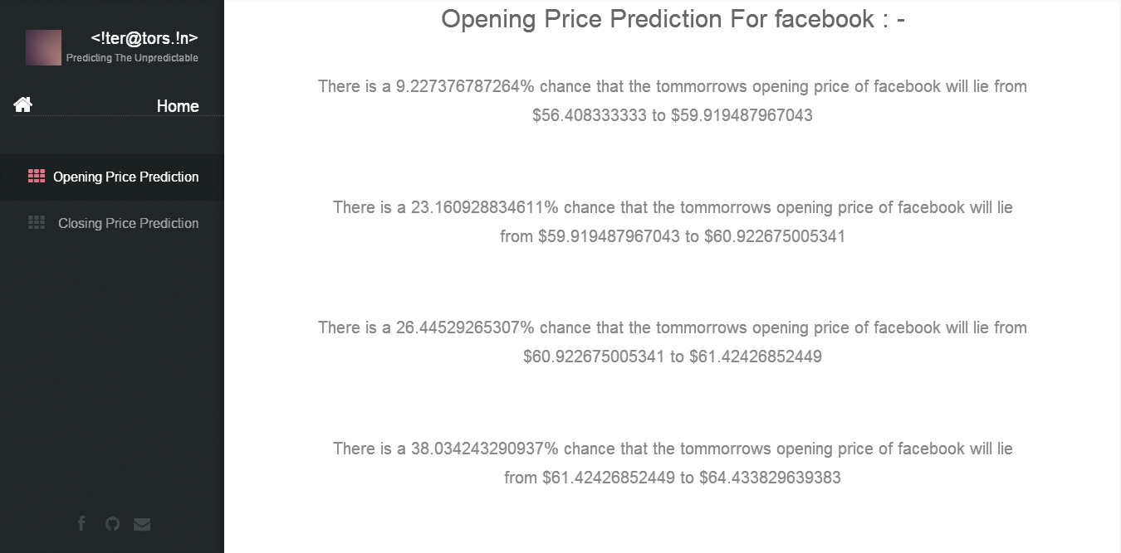

Slide 18
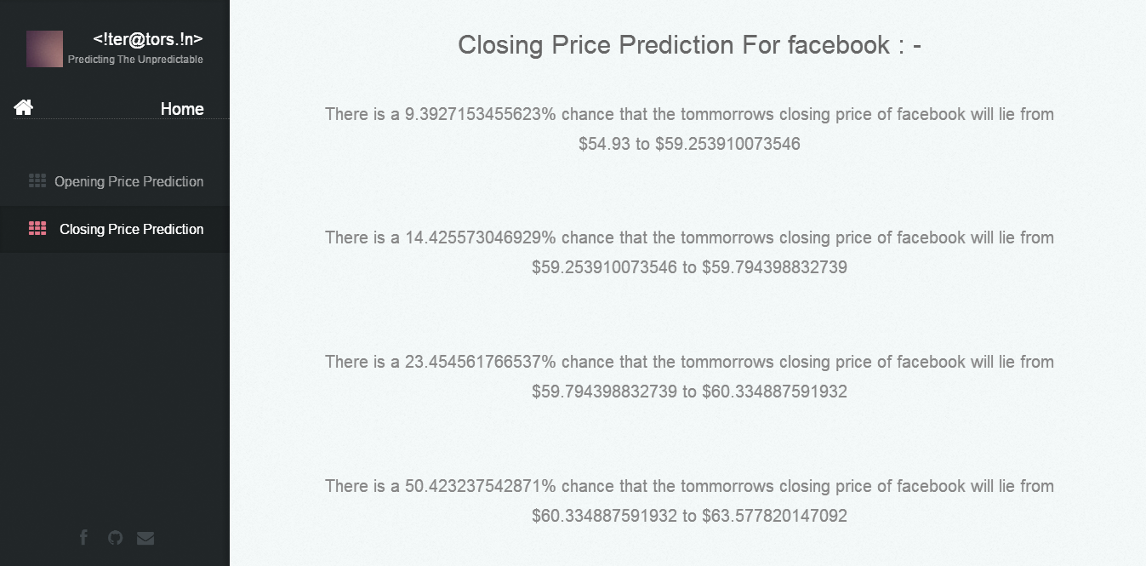

Slide 19
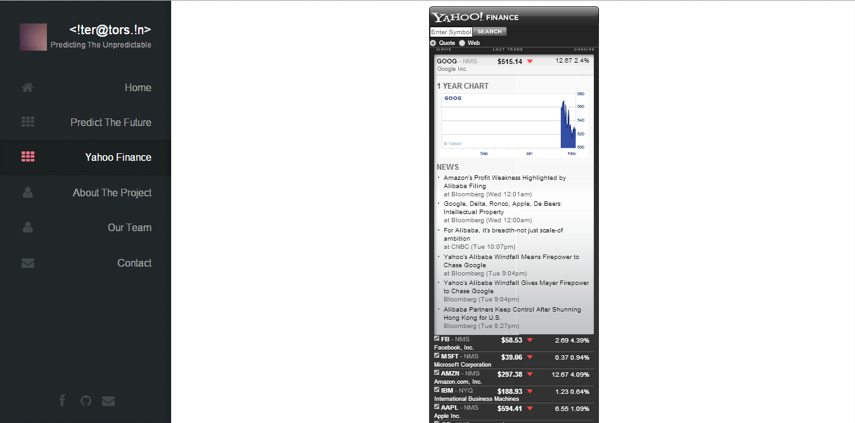

Slide 20
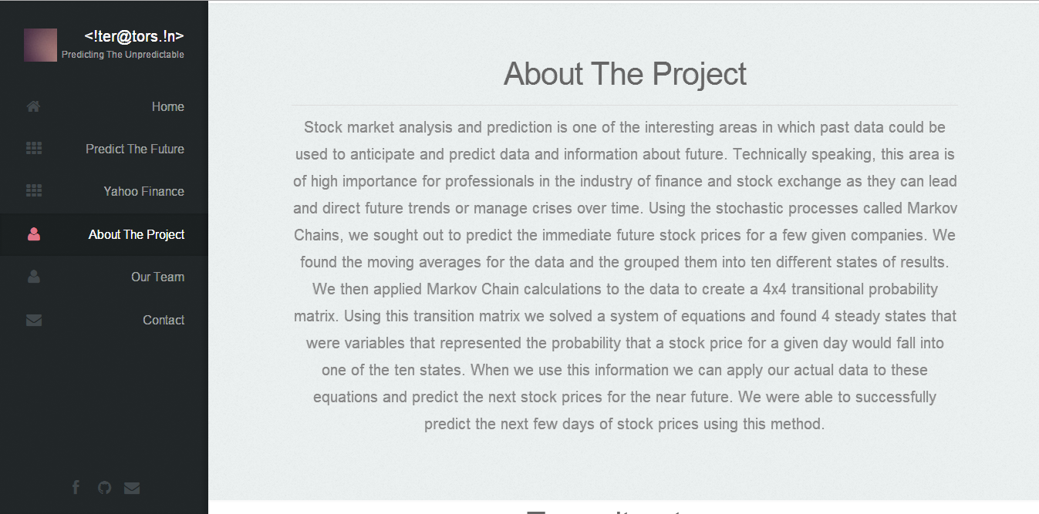

Slide 21


Slide 22


Slide 23
CONCLUSION
Our work thus far has implemented the use of Markov chains for predicting stock prices. Using the difference between forecast prices and actual prices, we have calculated the possible steady state, or probability of the future of the difference price.
We checked our app to make predictions for the selected stocks and the predictions were found to be nearly accurate.
Our app also provides current news feed related to selected stocks, in addition to the prediction, as we have linked it to Yahoo finance.
We are using historical data, from yahoo finance, of the companies which are listed in NASDAQ.
Our web app is scheduled for a CRON job to run a PHP script in order to update the data(based on which the predictions are made)
Thus, our app is ready to enter the market in order to help all the investors.

Slide 24
Future Work
Our project leaves a lot of scope for future enhancements. We can improve accuracy by implementing Hidden Markov model in conjunction with the Markov model.
If we are to take our work forward, we might also consider basing our calculations on deciles instead of quartiles (i.e 10 intervals instead of 4)
Although, nothing can be conclusively said about any prediction, it can be concluded that a lot of scope lies in the field of prediction based on such mathematical models.

Slide 25
REFERENCES
http://en.wikipedia.org/wiki/Markov_chain
http://www.math.uah.edu/stat/markov/
Predicting Stock Prices—(Approved Paper) by Shuchi S.Mitra and Michael J.Riggieri
http://stockcharts.com/help/doku.php?id=chart_school:technical_indicators:moving_averages
http://ichart.finance.yahoo.com/table.csv?s=YHOO&a=04&b=2&c=2014&d=04&e=3&f=2014&g=d&ignore=.csv
http://finance.yahoo.com/d/quotes.csv?s=fb&f=snal1d1t1opghx

